Slide 1


IC2023
Intelligent Forecasting of
Trademark Registration Appeal
with TF-IDF and XGBoost
Qun Wang, ShuHao Qian,
JiaHuan Yan, Hao Wang,
and XiaoTao Guo
Notes:
大家好，我的学术报告的主题是利用 TF-IDF 和 XGBoost 对商标驳回复审案件进行智能预测

Slide 2
Background
Research status at home and abroad
Purpose and significance
Research methods and ideas
Results and Conclusions
Innovation and deficiency
CONTENT
01
02
03

Slide 3
01
Background &
Research Status

Slide 4
Trademark Registration procedure
Application
for trademark
Registration
Pro Forma
Review
In 30 days
Substantive
Review
4-7 months
Provisional Approval Publication
3 months
Trademark Registration Announcement
No Opposition
During 3 months
Correction
In 15 days
Non-registration Adjudication
Rejected Appeal
Absolute Grounds for Refusal
Relative Grounds for Refusal
（similarity score)
Opposition
Partially Rejected
Rejected
Provisionally approved
Partially goods groups
are failed
Others are approved
All goods groups are failed
All goods groups are approved

Slide 5
Trademark rejected appeal related grounds
Graphic elements
image
words
look-
alike
transformation
character
similarity
Translation en -> zh
Semantic
Pronunciation
Polyphony
meaning
Tone

Slide 6
Trademark Rejected Appeal Process Timeline
 | Month 0 | Month 1 | Month 2 | Month 3 | Month 4 | Month 5 | Month 6 | Month 7 | Month 8 | Month 9 | Month 10 | Month 11 | Month 12
Application and Pro Forma
Substantive Review
Preliminary Announcement
Register
Rejected Appeal
Preliminary Announcement
Register
Application
For trademark
Registration
Pro Forma
Review
In 30 days
Substantive
Review
4-7 months
Provisional Approval Publication
3 months
Trademark Registration Announcement
No Opposition
During 3 months
Correction
In 15 days
Non-registration Adjudication
Rejected Appeal
Absolute Grounds for Refusal
Relative Grounds for Refusal
（similarity score)
Opposition

Slide 7
Actual Needs Call for a Predictive Model
NESSITY
Applicant
Attorney
Judges
Trademark is faster than market
save time
-> earn money
Applicant needs the attorney to tell the success rate
Case too many
But the judges are too less than the cases
-> High-quality trademark applications. -> improve efficiency
benefits applicants & judges

Slide 8

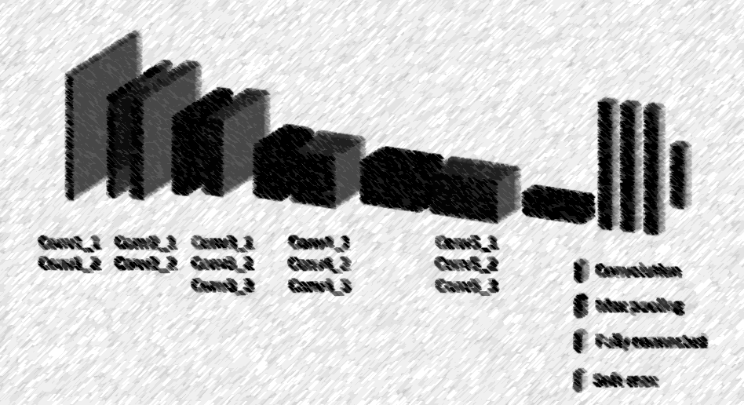
NLP
Research status on trademark and ML
Similarity Analysis for Opposition Decision
SVM + KNN
category 34
Feature
Extraction
10+
natural scene recognition of trademarks
10+
Prediction Model In Opposition
Onomatics
3000+ of USPTO TTAB. & 20000+ of OHIM
similarity retrieval of graphical trademarks
30+
Feature Extraction In Appeal
TF-IDF + LDA
4,835 Cases of USPTO &. Federal court
cv
Feature
Fusion
6+
Prediction Model In Rejection Appeal

Slide 9

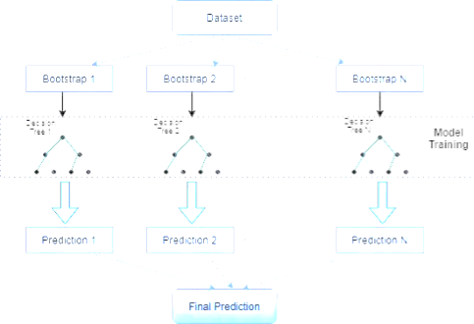
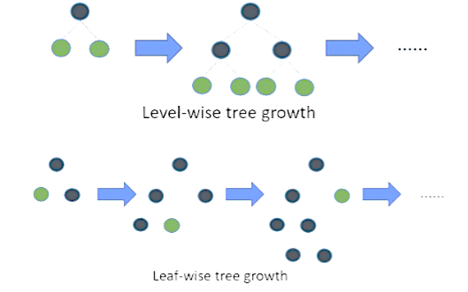
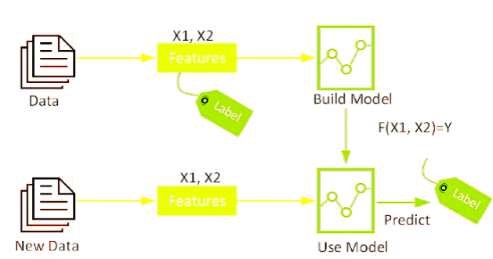
Relative Tech Development
ML From Decision Trees to XGBoost
Supervised Learning
Ensemble Learning
Gradient Boosting
a category of machine learning that uses labeled datasets to train algorithms to predict outcomes and recognize patterns.
Ensemble learning is a combination of several weak learners, which can become strong learners.
Voting, Averaging, Stacking, Blending, bagging, Boosting, etc.
Gradient boosting is an extension of boosting where the process of additively generating weak models is formalised as a gradient descent algorithm over an objective function. Famous as XGBoost, LightGBM, CatBoost ,etc.
1960s
1990s
2010s

Slide 10
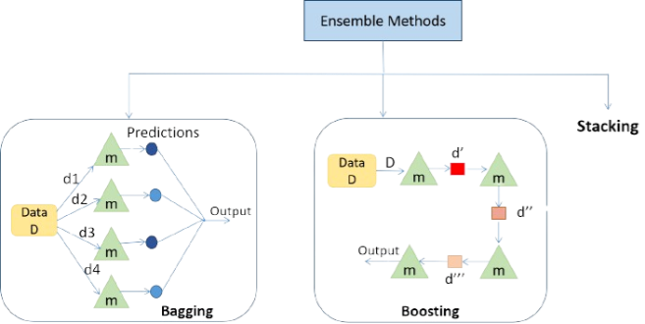
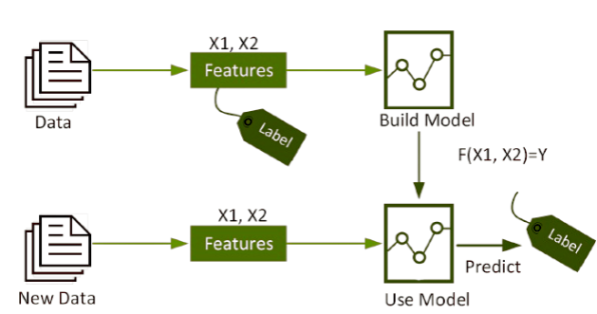
Machine learning & Ensemble learning
Ensemble learning
voting
Machine learning
bagging
stacking
average
blending
Bootstrap sampling
boosting
Supervised learning
Gradient boosting
AdaBoost
XGBoost
CatBoost
LightGBM

Slide 11
02
Experiment Design

Slide 12
Experimental procedure
Begin
Data processing
To construct a predictive model for reviewing trademark registration refusals, we conducted
feature engineering using mutual information scores and cosine similarity from TF-IDF,
partitioned the data into training, validation, and test sets,
optimized the XGBoost model parameters with GridSearchCV and k-fold cross-validation, achieving 68% accuracy, and then
performed a comparative analysis of feature importance for model interpretation.
Feature engineering
Partition the data
Valid Set 15%
Training Set 70%
Test Set 15%
XGBoost Classification Model Fitting
GridSearchCV
K-fold cross validation
Compare MI Score with feature importance and feature analysis
Done

Slide 13

Data Process
Feature extraction
Data collection
brandName、ID、content、cited_brand_number、cited_brand_name、rejection_result、legal_basis、rejected_goods、passed_goods … …
From Chinese Trademark Office
Trademark Review and Adjudication Rulings/Decision Instruments
Data clean
dealing with missing values
above 90% threshold are deleted.
imputed with appropriate strings,
Feature engineering
categorization labeling
to change the appeal results
TF-IDF build words embedding space
Cos similarity build new feature

Slide 14
Feature extraction
Cited_BrandName
goods
legal_basis
BrandName
ID
applicant
rejection_result
groups
Authorized_agent
category
Main_reason

Slide 15
Feature extraction
BrandName
Cited_BrandName
Authorized_agent
Basic info
Legal fact
Category & goods
applicant
legal_basis
Main_reason
rejection_result

Slide 16
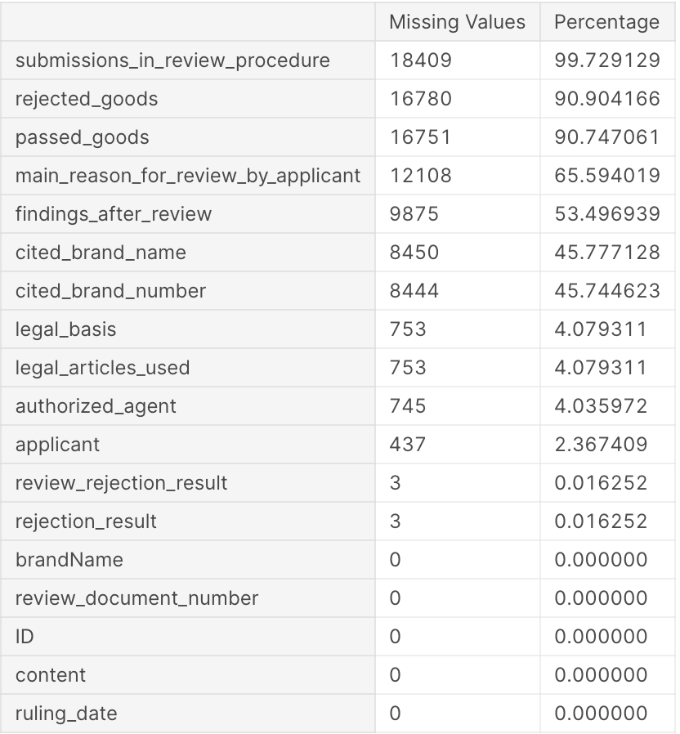
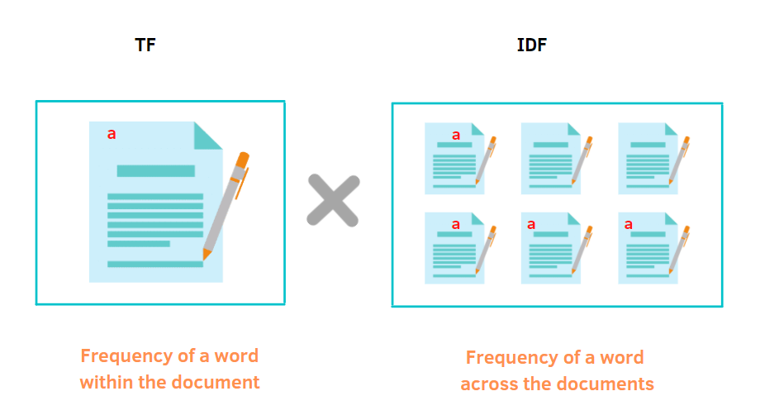
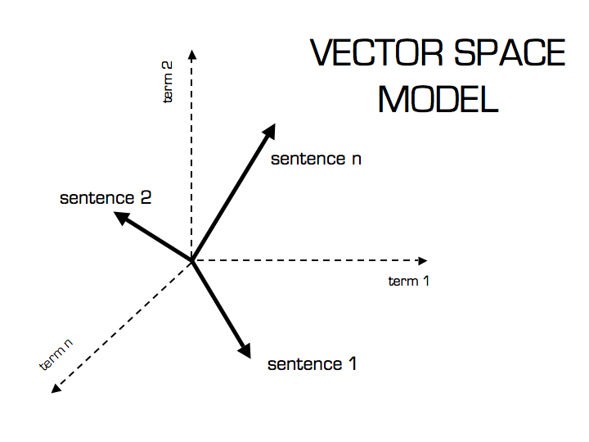
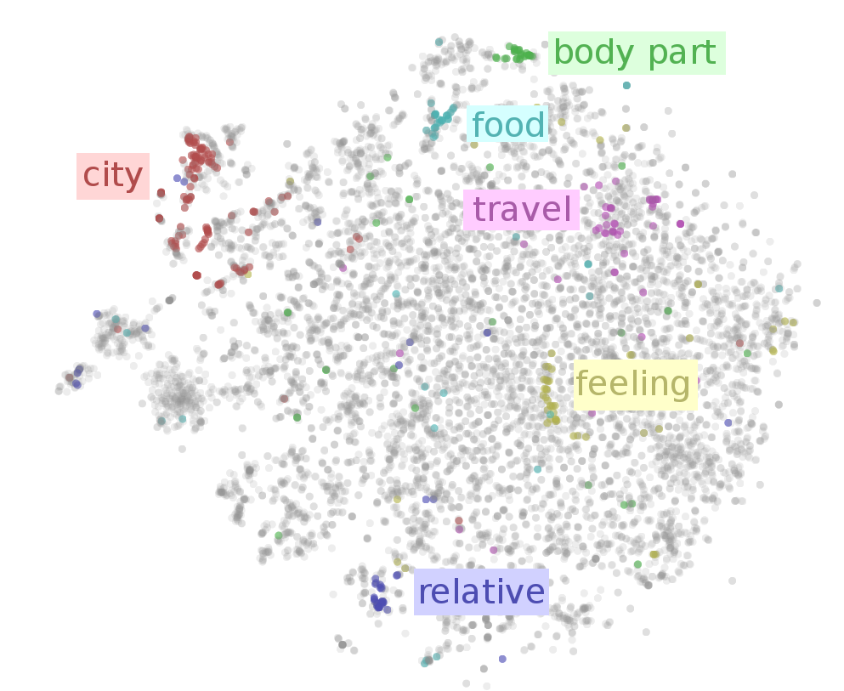
Feature Engineering
TF-IDF
New feature：
similarity
Cosine similarity
Ordinal encoding
Rejection Result
Rejected
Provisionally Approved
Partially Rejected
Rejection Result
0
1
2
New feature : Similarity
0
0.0000000

Slide 17
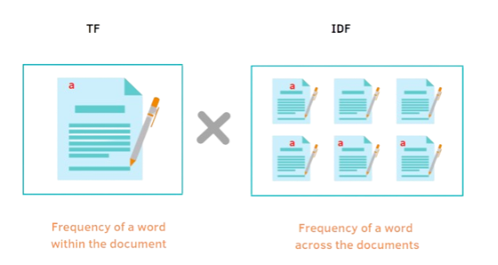
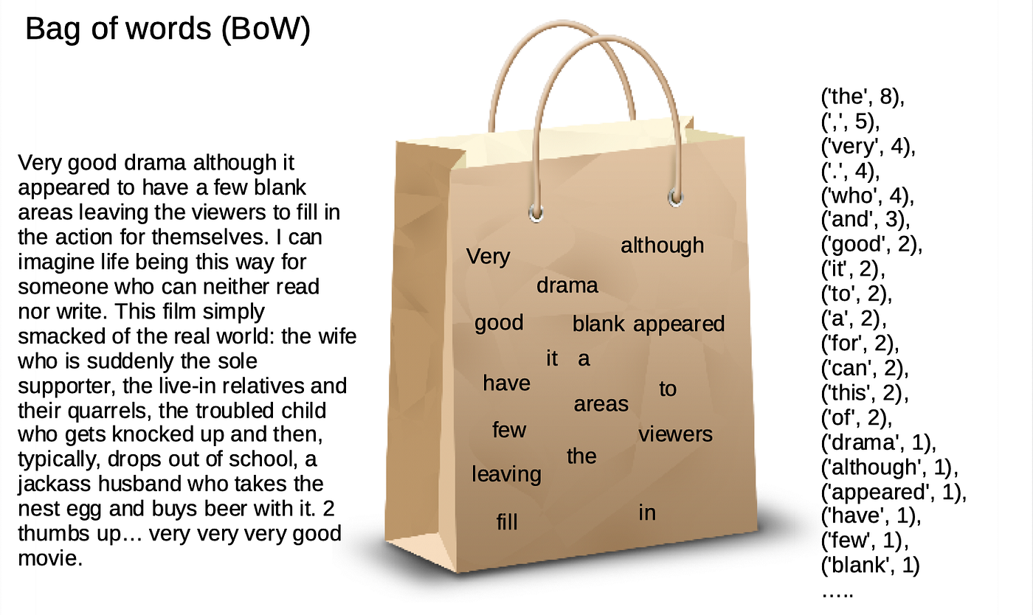
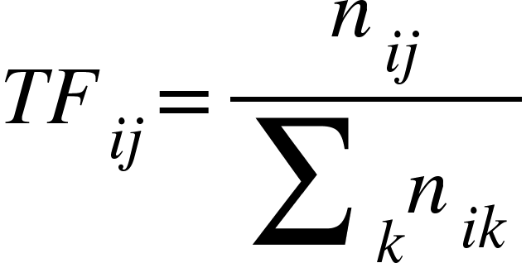
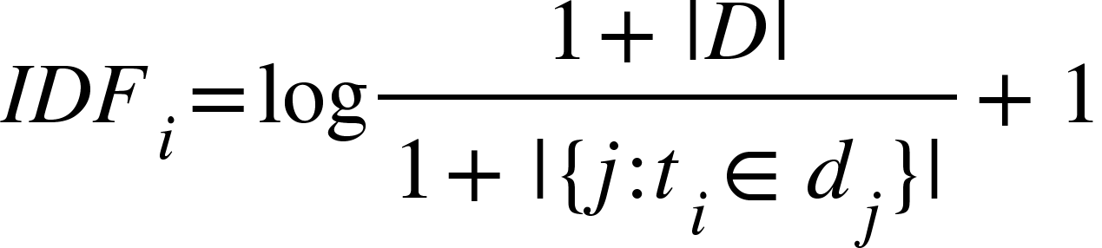
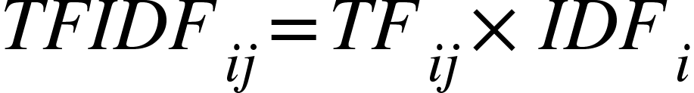
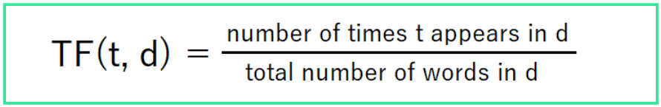
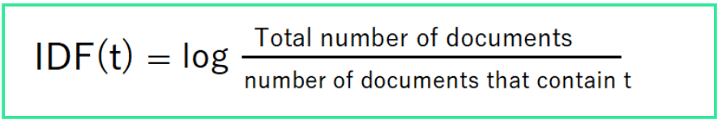
TF-IDF
Inverse document frequency
Frequency of a word across the documents
Total number of docs
Number of doc contains word
Tokenization
D -> Bags Of Words
Term frequency
Number of times a word appears in doc
Total number of words in doc
x

Slide 18
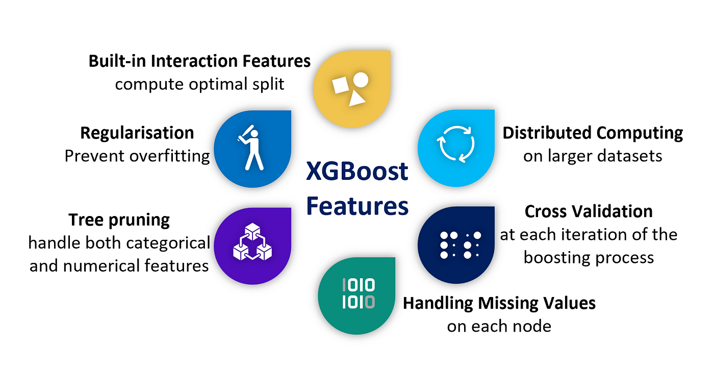

Slide 19
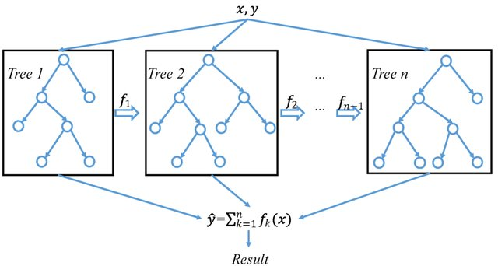
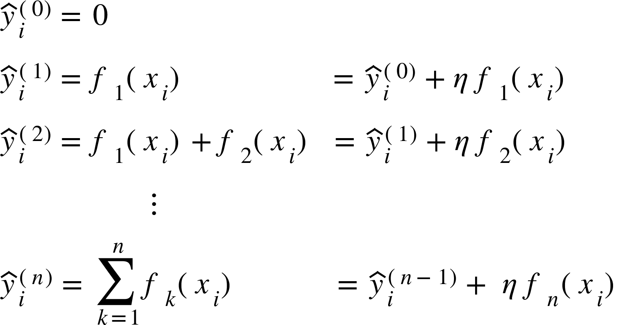
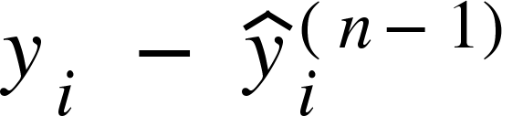
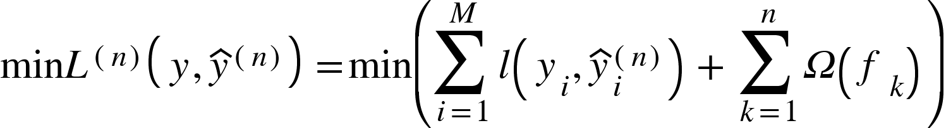

XGBoost
1. Initialization
4. Sum
5. iteration
Built-in missing value process
2.Predict residuals
Column samples
3. shrinkage
Parrallel process
Cross validation
Target : loss function (residuals + regularization)
Notes:
构建第一棵树（这里列抽样取数据集的子集）
观察误差 $ y_i - \hat{y}_i = \text{residuals}$ 构建新的树预测误差， 为$f(x_i)$
3. 加入shrinkage策略，以$\eta$ 的权重乘上新树的$f(x_i)$
4. 将预测残差的新树乘步长再加到原来的树上
整个过程的目标是最小化包含残差及正则项的损失函数（可微），
5. 重复2～4， 直到达到需要构建的树最大数量 或者 达到早停的约束条件
6. 得出结果

Slide 20
03
Experiment Evaluate

Slide 21
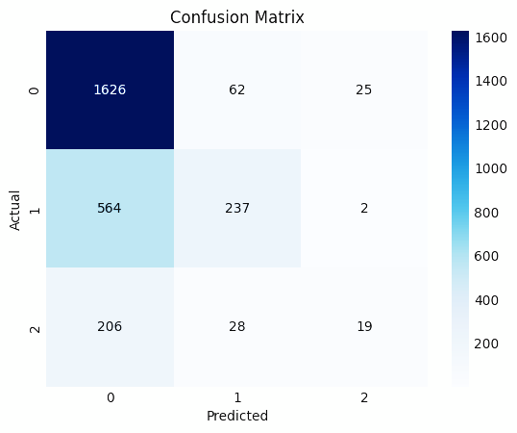
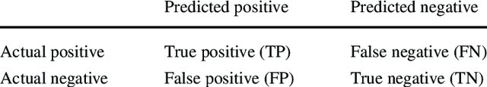
Experiment result
 | TP | FP | FN | TN
Rejected | 1626 | 770 | 87 | 1173
Provisionally Approved | 237 | 90 | 566 | 2763
Partially Rejected | 19 | 27 | 234 | 3376
True Positives (TP): Number of instances correctly predicted as positive.
False Positives (FP): Number of instances incorrectly predicted as positive.
True Negatives (TN): The number of instances correctly predicted as negative.
False Negatives (FN): Number of instances incorrectly predicted as negative.
Notes:
Confusion Matrix Visualizing Classification Performance. The matrix delineates the number of true positives, false positives, false negatives, and true negatives for each category predicted by the model. The shades of blue represent the magnitude of instances in each category, with darker shades indicating higher frequencies. Category '0' denotes Rejected, '1' corresponds to Provisionally Approved, and '2' signifies Partially Rejected cases. The vertical axis represents the actual classes, while the horizontal axis indicates the predicted classes by the model.

Slide 22

Experiment result
Overall evaluation
Category evaluation
a high accuracy 68%
in predicting the majority of samples.
for challenging samples is more limited : recall of 2 category is low
68%
A Category imbalance
in the dataset about
1:4:8
category imbalance 1:4:8
cause the model to be less sensitive to those less common categories
to address the problem : resampling, SMOTE, etc.
 | Partially Rejected | Provisionally Approved | Rejected | overall
support | 253 | 803 | 1713 | 2769
Notes:
To address the category imbalance,
resampling (oversampling less common categories or undersampling more common categories),
synthetic minority oversampling techniques (SMOTE),
adjusting the classification threshold or assigning different weights to samples from different categories.

Slide 23
Feature analysis
MI Scores feature ranking
XGBoost feature importance
1
BrandName
4
2
Cited_brand_name
3
3
Authorized agent
1
4
Main_reason
4
5
similarity
5
Notes:
The higher the importance index is, the stronger the ability of the feature variable to distinguish between good and bad samples is.

Slide 24
First prediction model
For rejected appeal
text vectorization
Sota method
68% accuracy
Dataset Category imbalance
Novelty
Limitation
New dataset
Visual feature
& modality
Code Open Source
@ github

Slide 25
References
[1] Chen, T., Guestrin, C.: XGBoost: A Scalable Tree Boosting System. In: Proceedings of the 22nd ACM SIGKDD International Conference on Knowledge Discovery and Data Mining, Aug. 2016, pp. 785–794. doi: doi: 10.1145/2939672.2939785
[2] GAO Jiaxi, HUANG Haiyan. Text Emotion Analysis Based on TF-IDF and Multihead Attention Transformer Model[J]. Journal of East China University of Science and Technology. doi: 10.14135/j.cnki.1006-3080.20221218002
[3] Zhang, H., & Wang, X. (2023). Dynamic Application of Trademark Preliminary Publication Notification Data in Tobacco Enterprises Based on Semantic Similarity and Machine Learning Method. Proceedings of the 12th International Conference on Logistics and Systems Engineering, 475–488
[4] Ronkainen, A. (2013). Intelligent trademark analysis: experiments in large-scale evaluation of real-world legal AI. In Proceedings of the Fourteenth International Conference on Artificial Intelligence and Law (pp. 227-231). ACM.
[5] Li, A. S., Trappey, A. J. C., & Trappey, C. V. (2020). Intelligent Identification of Trademark Case Precedents Using Semantic Ontology. In Transdisciplinary Engineering for Complex Socio-technical Systems (pp. 534–543). IOS Press.
•••••••

Slide 26

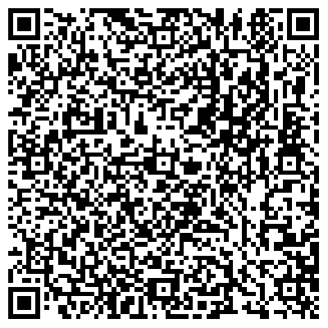
Thank you for listening
The code is open source at
https://github.com/ValeriaWong/Trademark_Appeals
"The best way to predict the future is to invent it." - Alan Kay
You can access the dataset
by sending a request email to
202230311326@stu.shmtu.edu.cn
You can contact for more help
gxthdu@gmail.com
pls feel free to give us advices

Slide 27
IC2023
Intelligent Forecasting of
Trademark Registration Appeal
with TF-IDF and XGBoost
Qun Wang, ShuHao Qian, JiaHuan Yan, Hao Wang, and XiaoTao Guo

Slide 28
Intelligent Forecasting of Trademark Registration Appeal with TF-IDF and XGBoost
Qun Wang, ShuHao Qian, JiaHuan Yan, Hao Wang, and XiaoTao Guo

